Slide 1




Slide 2

Analyze the text of Oscar-nominated movies to identify the most commonly used words and determine if any are associated with great movies.
Data collection from online sources, data preprocessing to remove irrelevant information, data analysis using NLP techniques to identify common words and phrases.
Identification of commonly used words and phrases, determination of elements associated with great movies, comparison of results with critical and commercial success of movies to identify any correlations.
Analysis of Oscar-nominated movies for commonly used words can provide valuable insights into the characteristics of great movies, useful for filmmakers, movie studios, and critics.
PRESENTING THE
IDEA

Slide 3

PRESENTING
META DATA
Analyzing movies provides insights into audience preferences and trends in the film industry.
Elements to consider include genre, runtime, rating, and plot summary.
Identifying the genre helps understand the story type, tone and style.
Examining the plot summary gives a glimpse into the story, themes and motifs explored in the film.

Slide 4
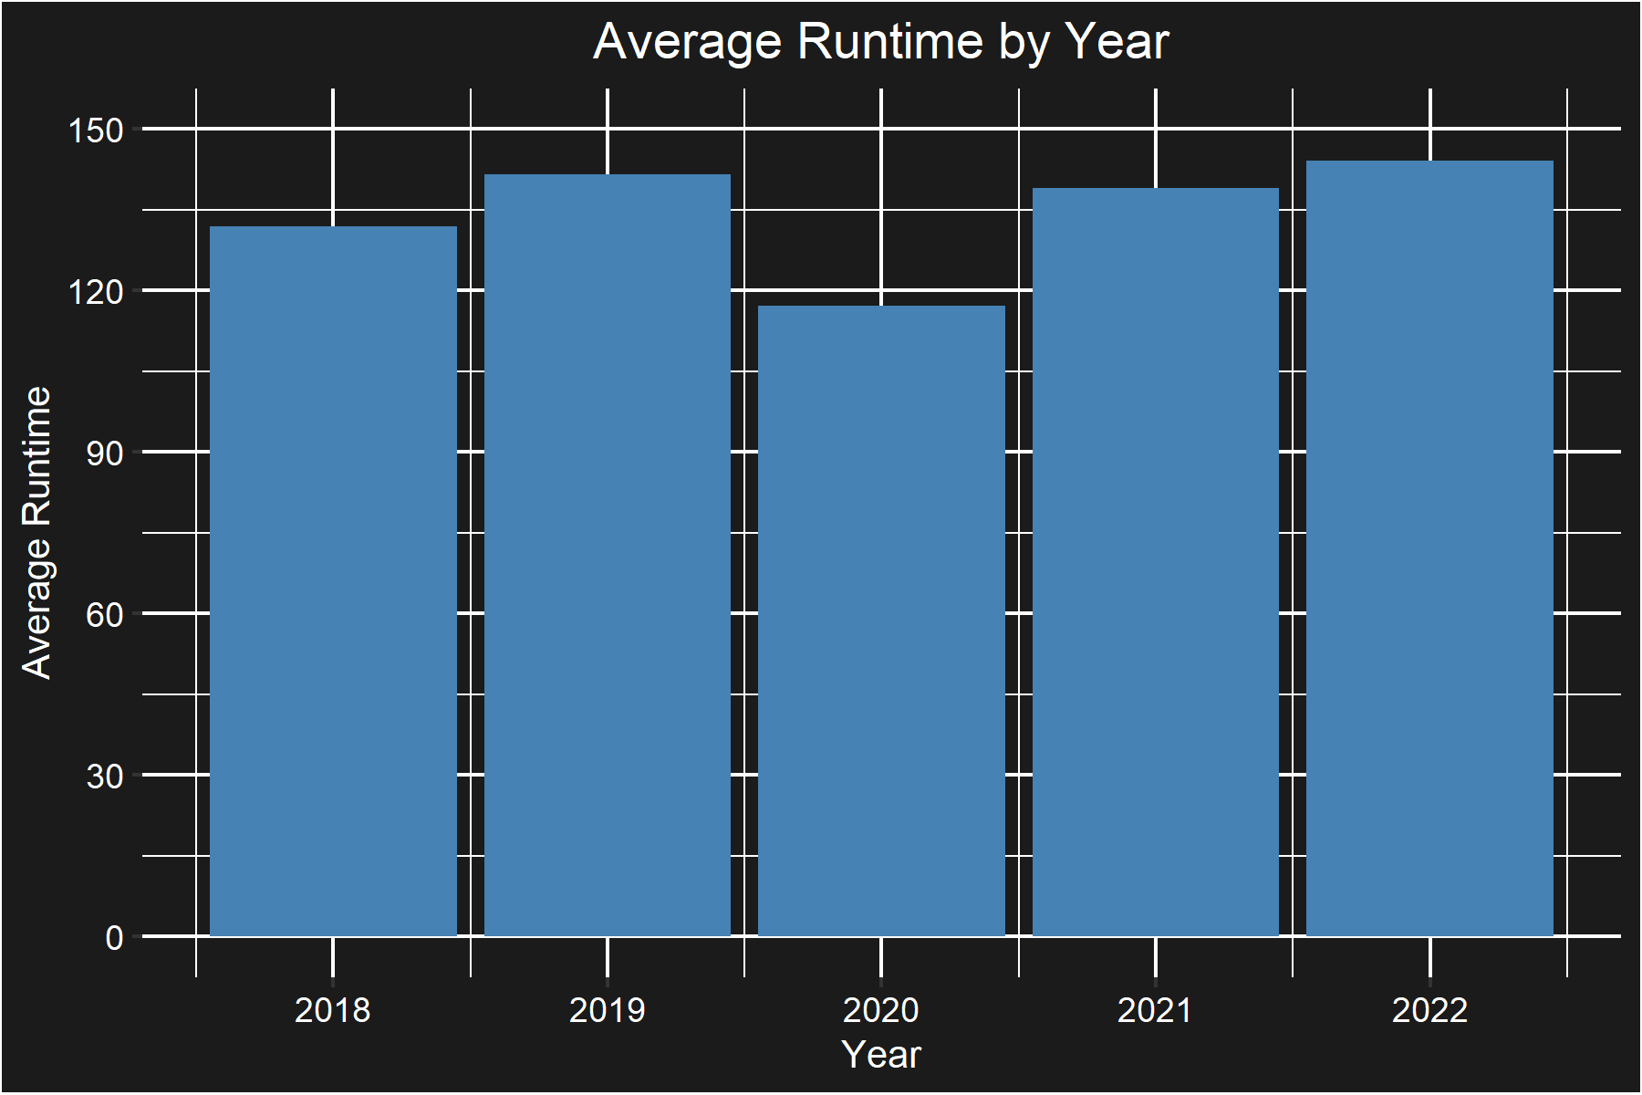
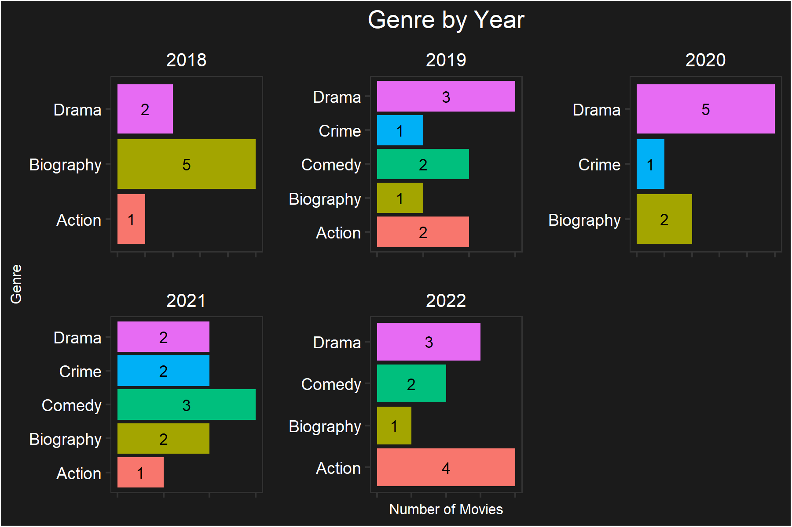
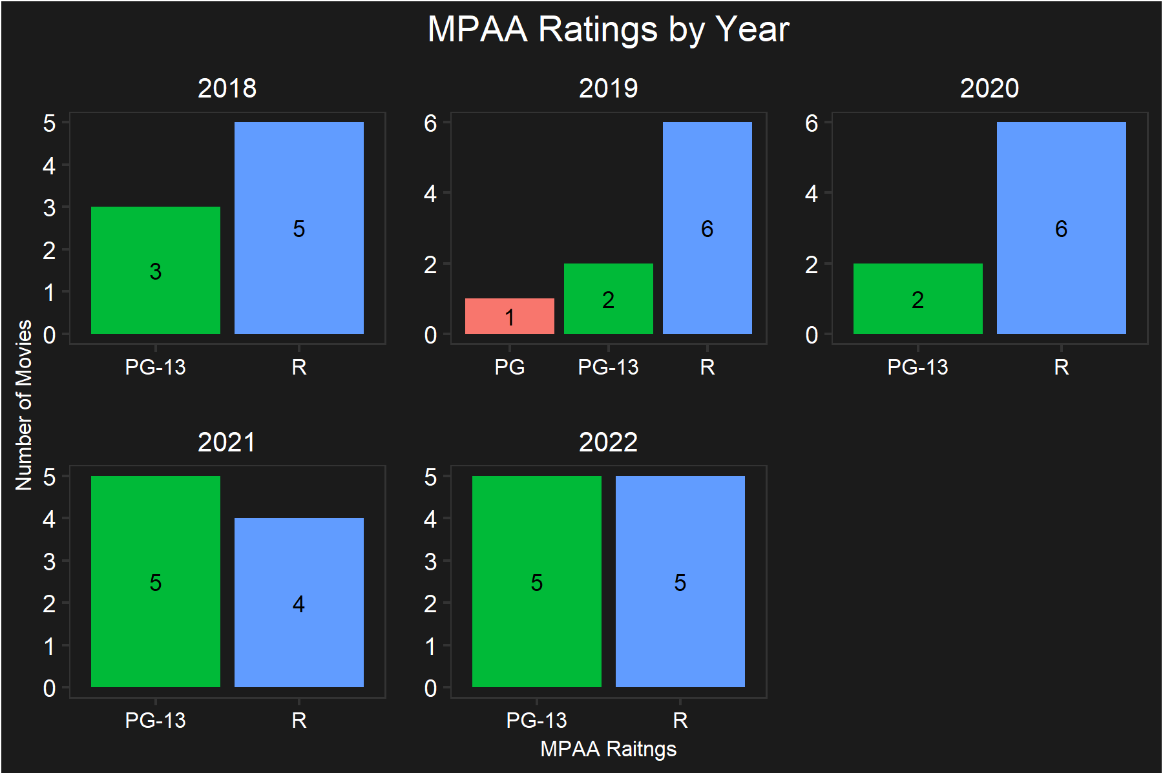
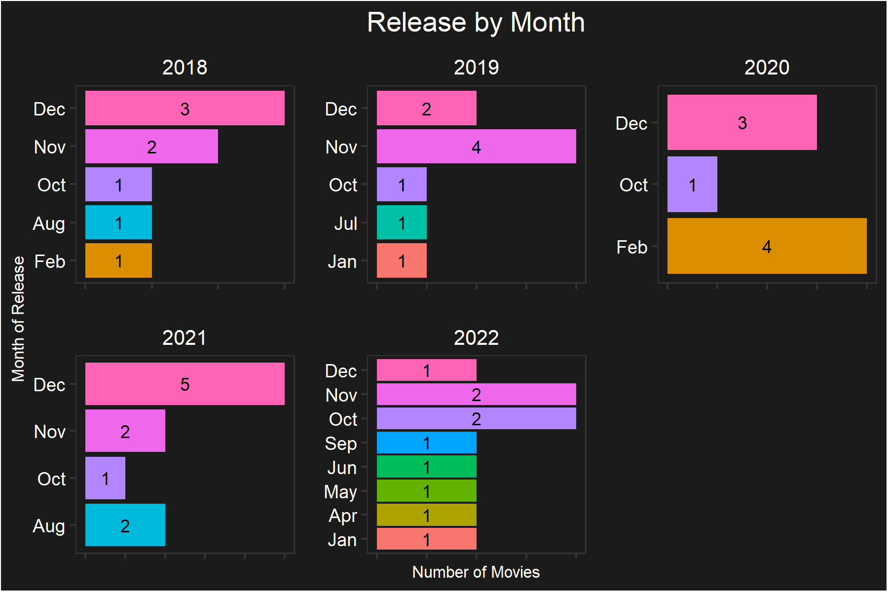
PRESENTING
Cinematic Insights

Slide 5
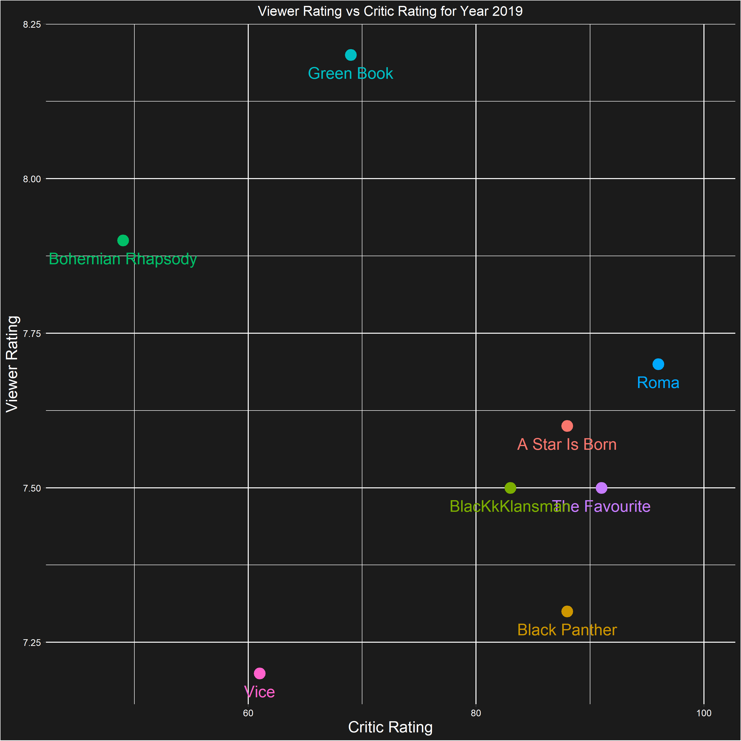
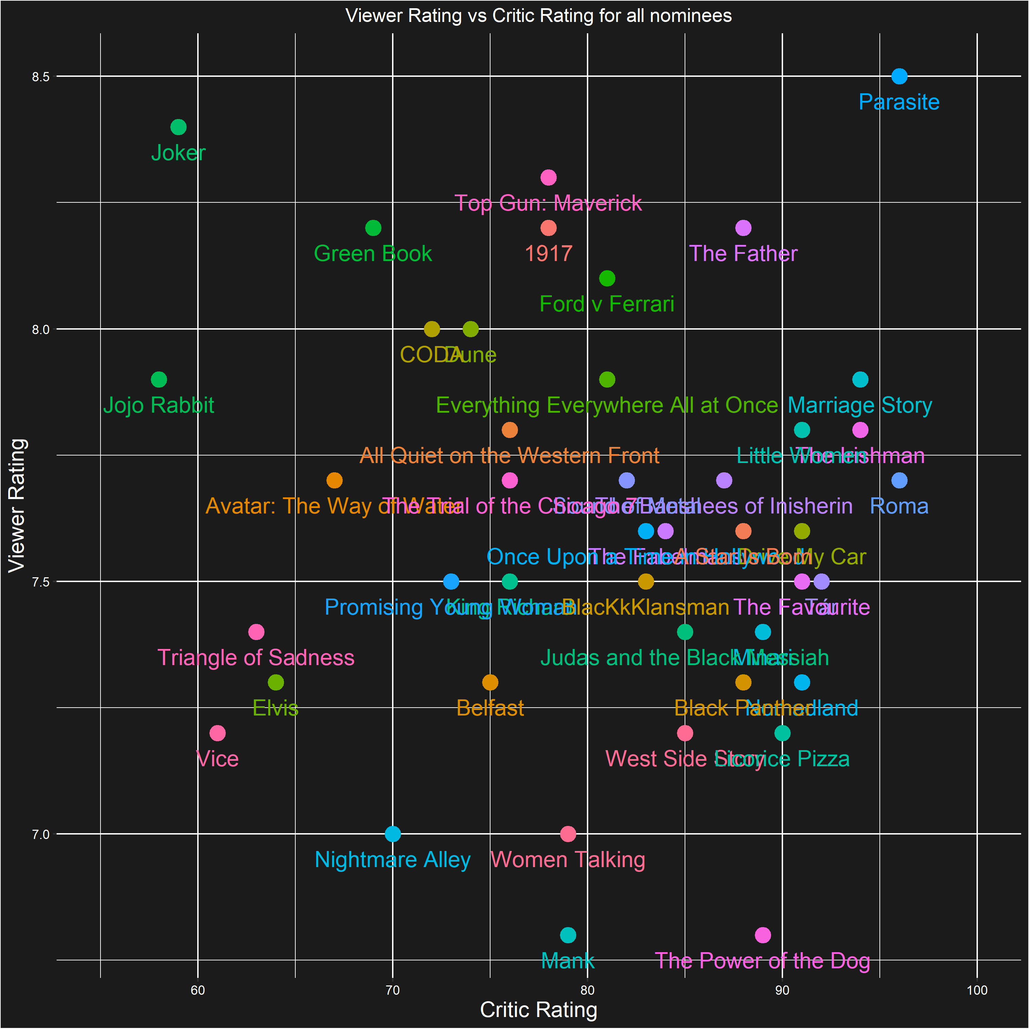
PRESENTING
CRITIC RATING

Slide 6
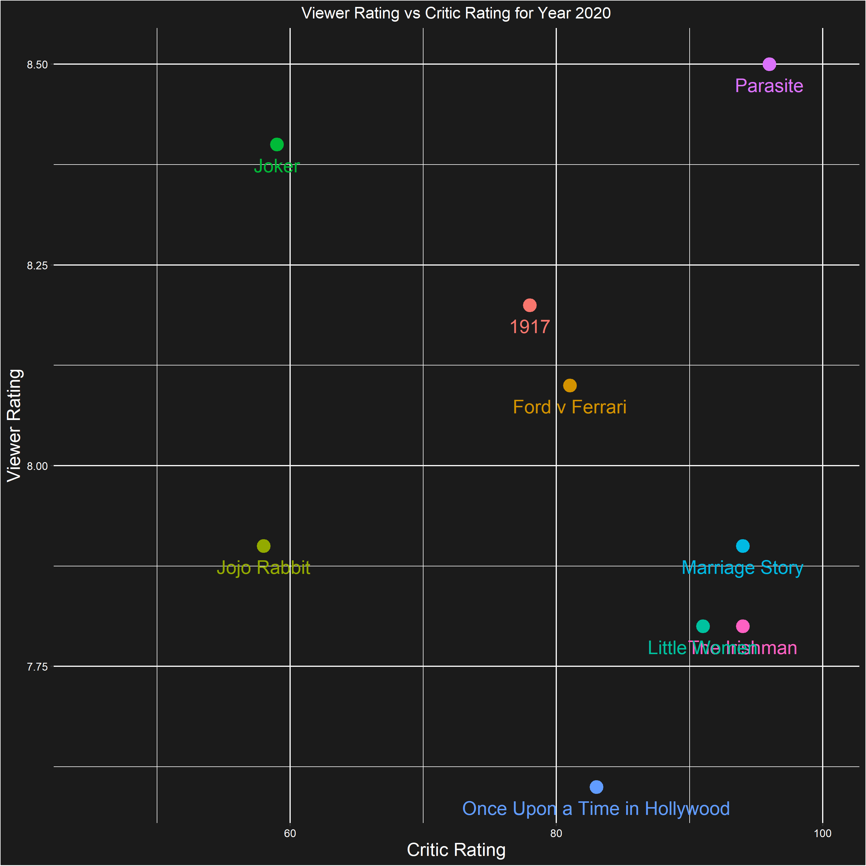
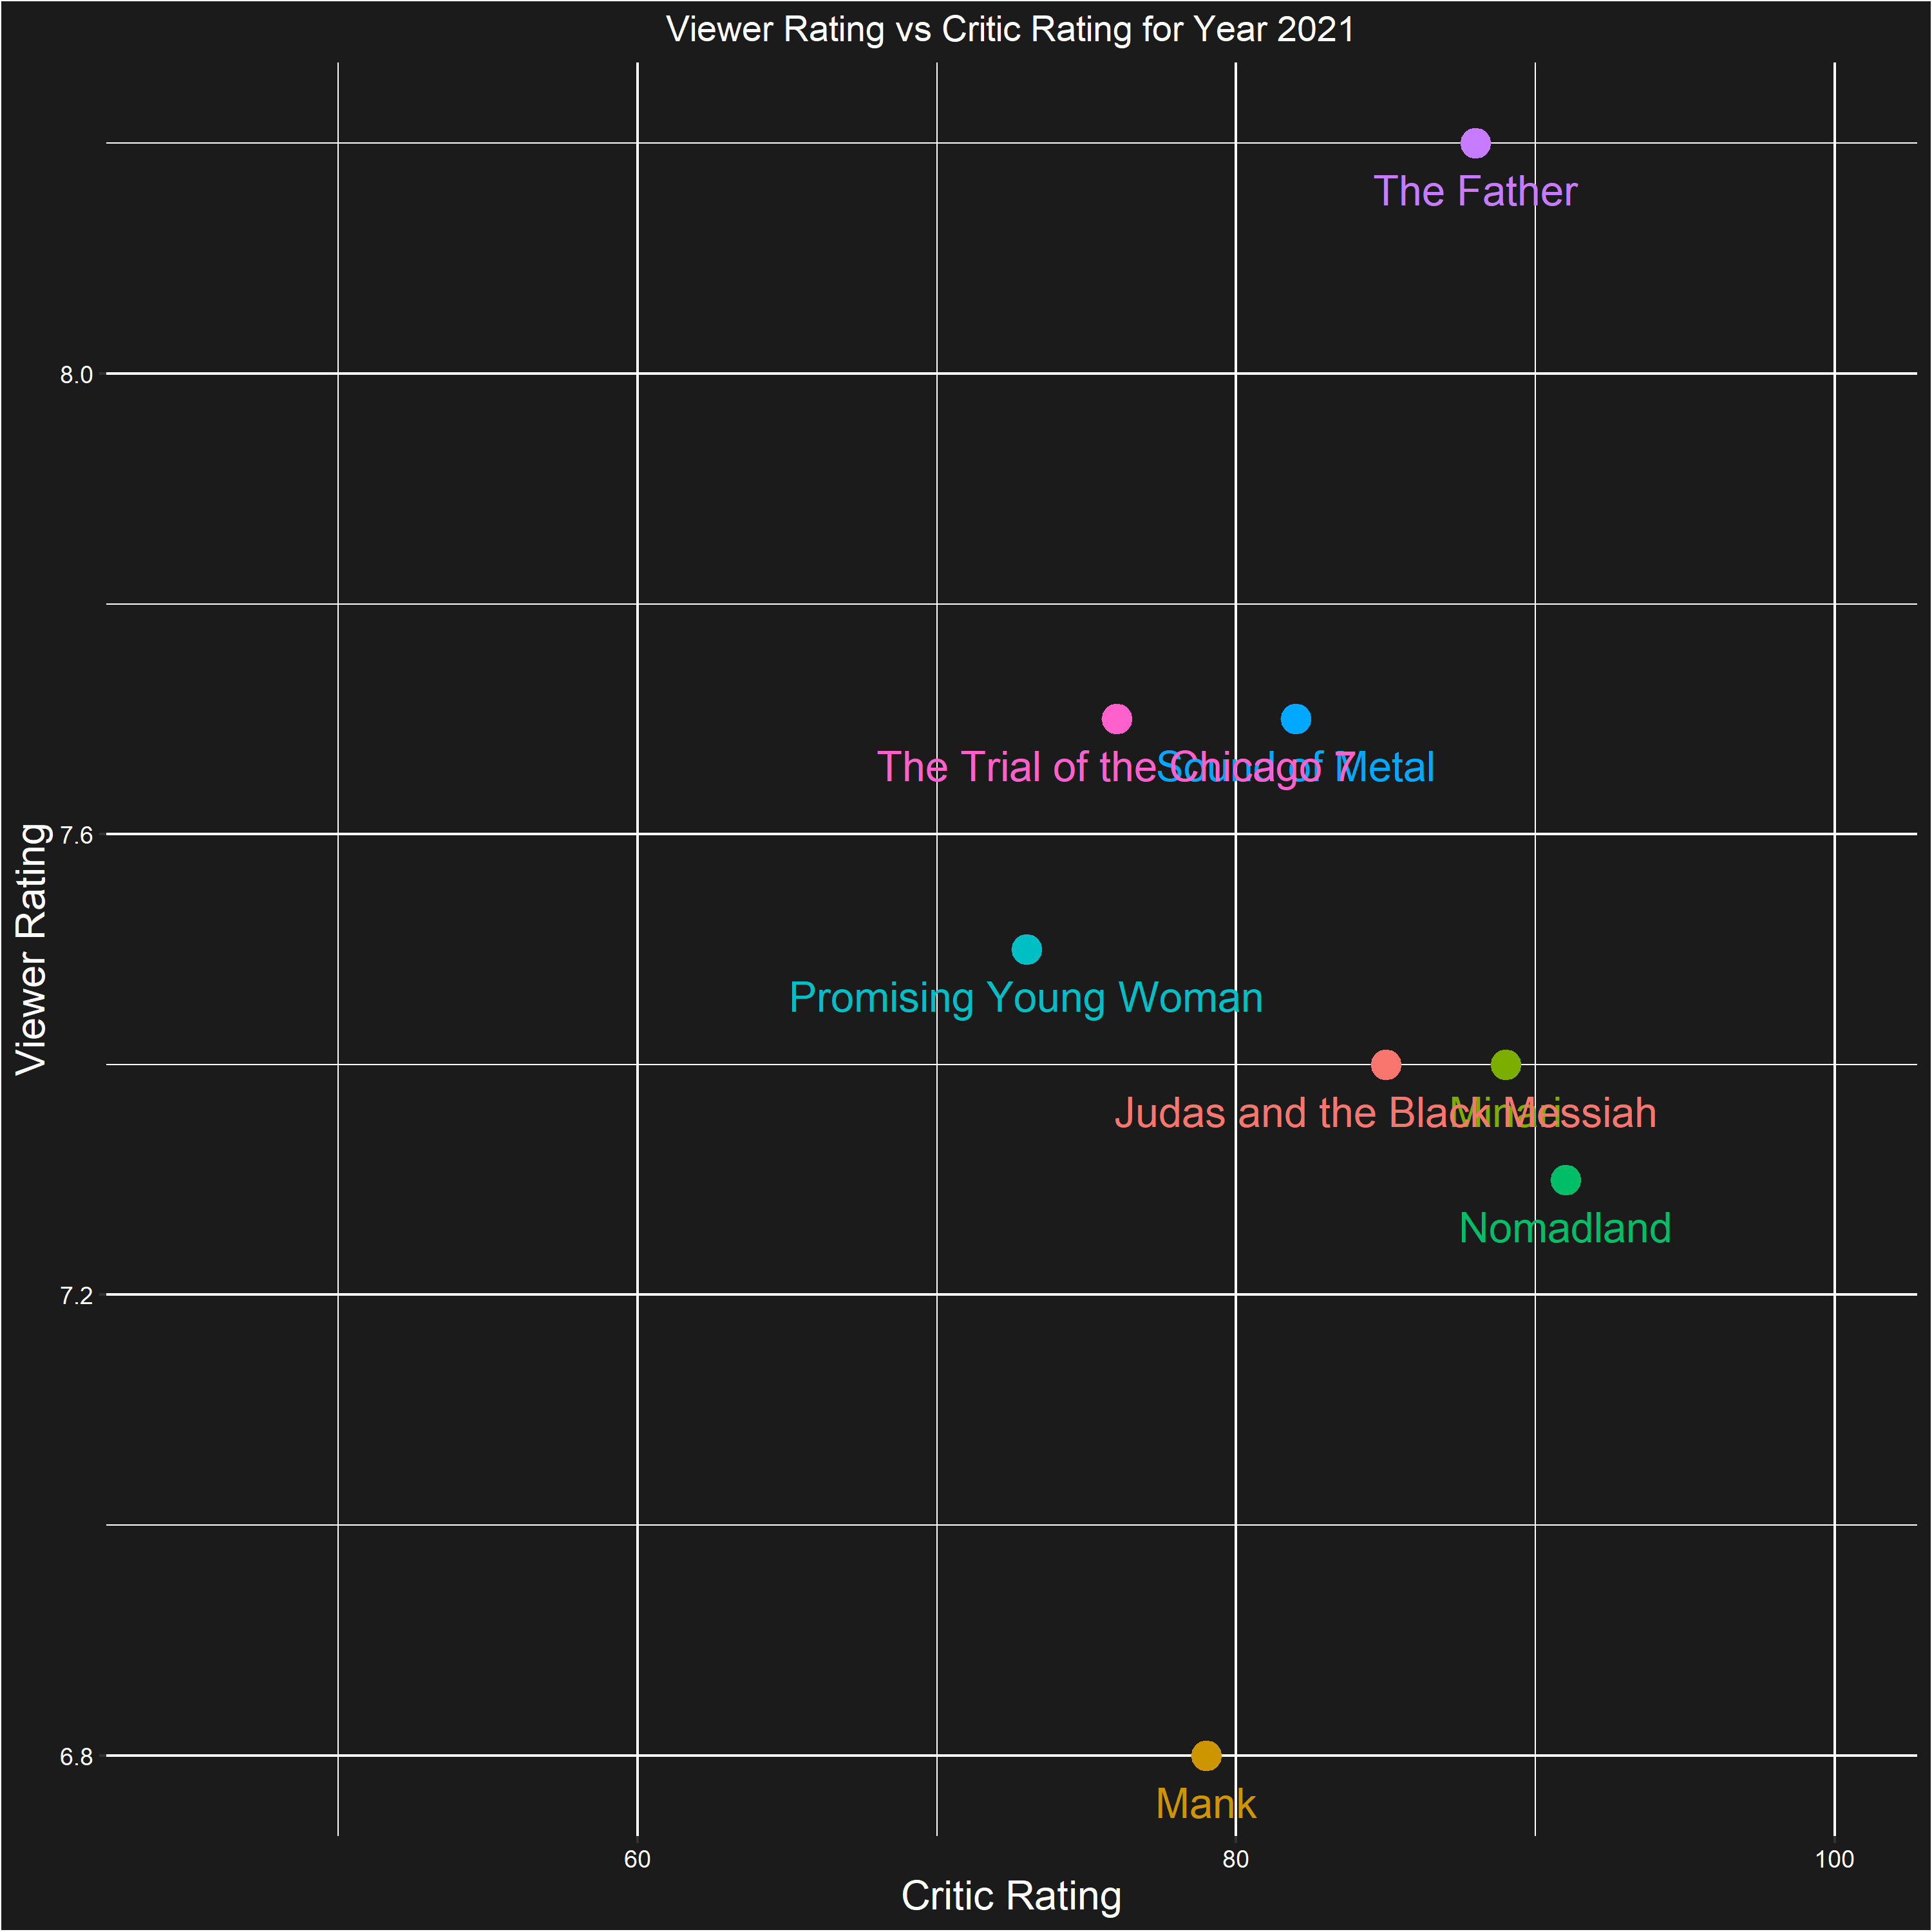
PRESENTING
CRITIC RATING

Slide 7
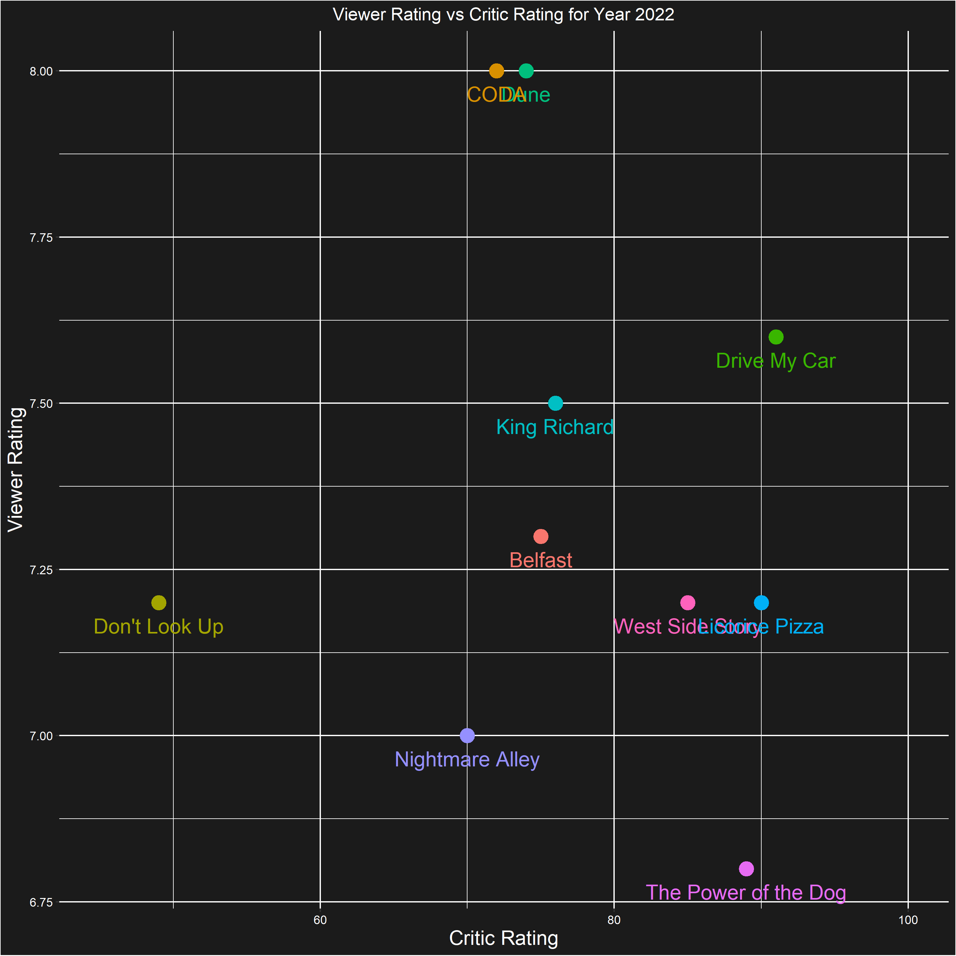
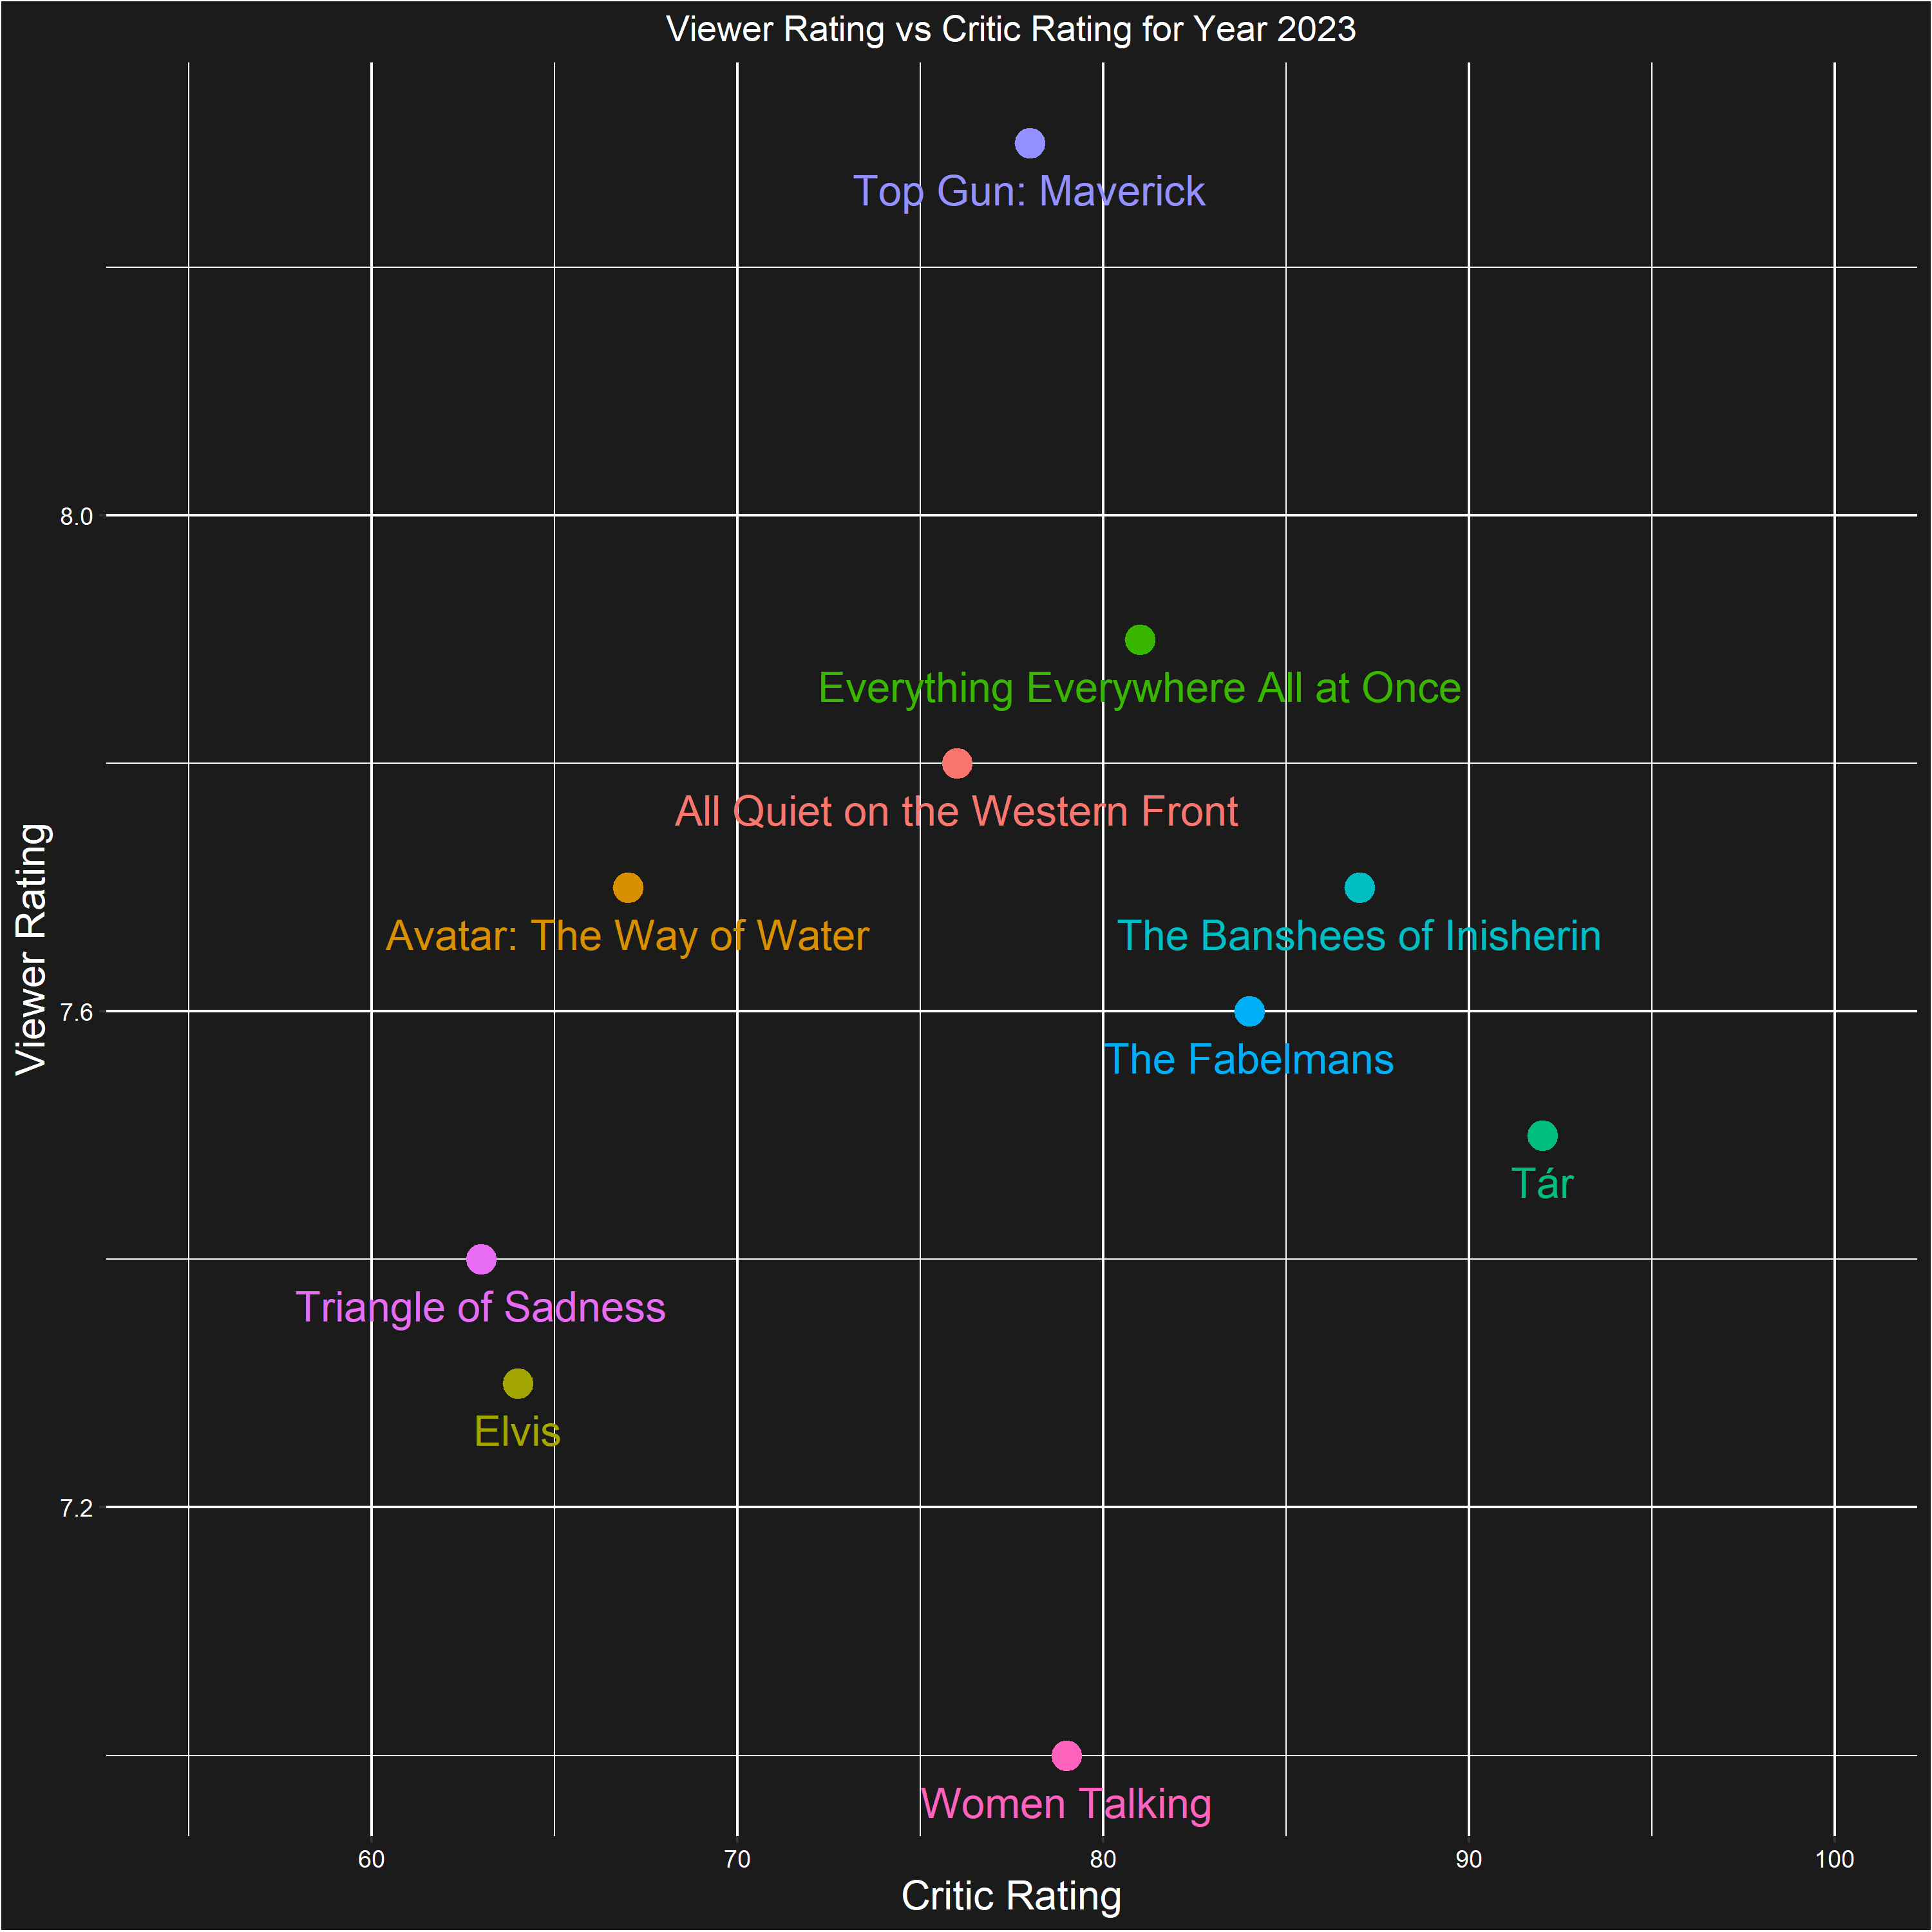
PRESENTING
CRITIC RATING

Slide 8
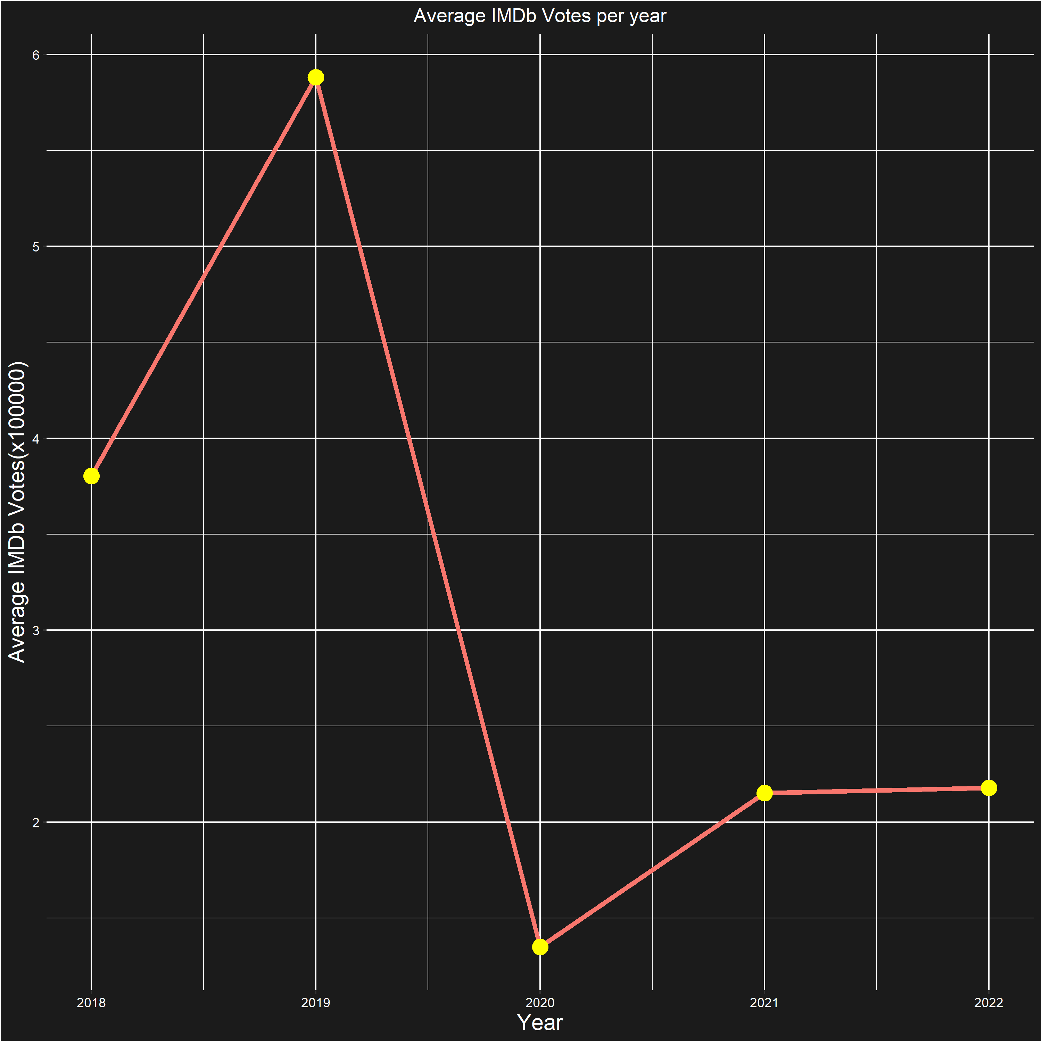
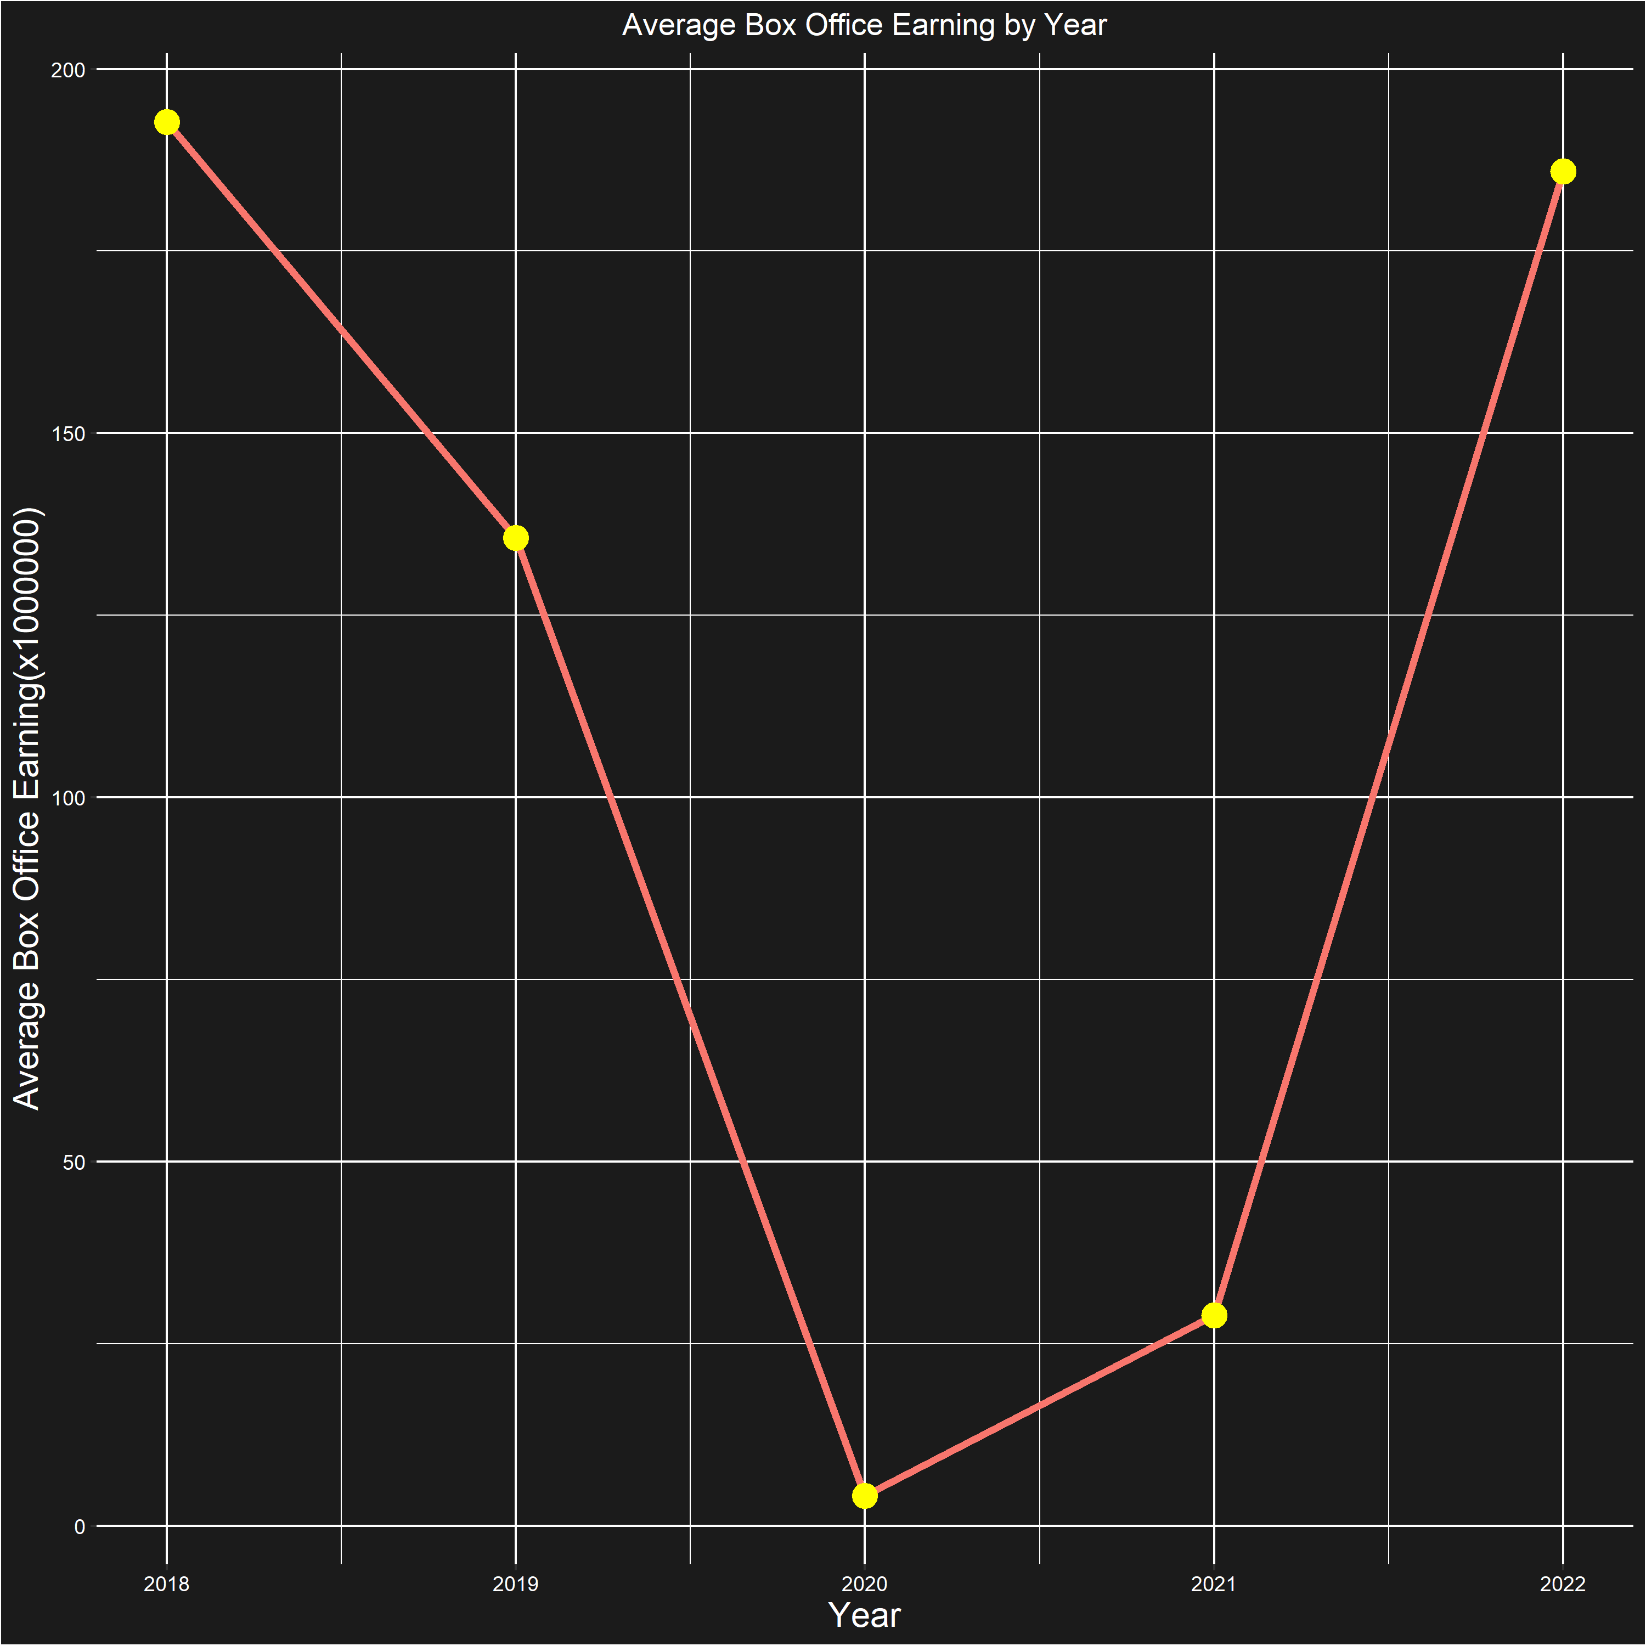
PRESENTING
BOX OFFICE TRENDS

Slide 9

PRESENTING
SCRIPT SENTIMENT
The Bing lexicon is a sentiment analysis tool that can be used to analyze the sentiment of text.
The sentiment analysis performed by the Bing lexicon assigns a positive or negative score to individual words based on their emotional connotations.
Analyzing the screenplays of the nominees using the Bing lexicon can help us determine whether the overall sentiment of the screenplays is positive or negative.
This type of analysis can provide valuable insights into the emotional impact of the screenplays and help us understand why they were nominated for awards.

Slide 10
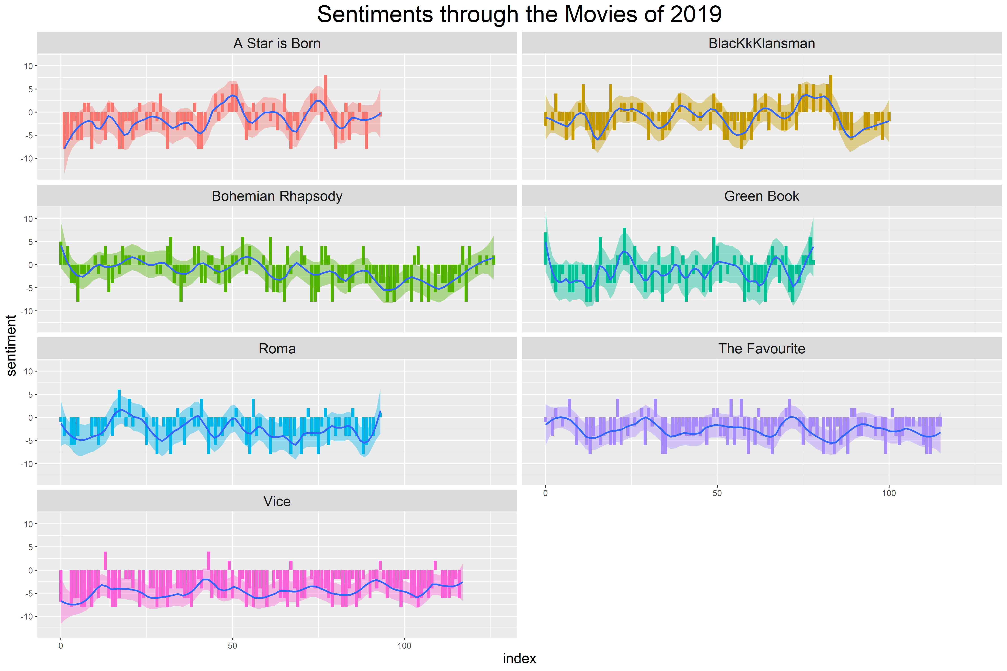
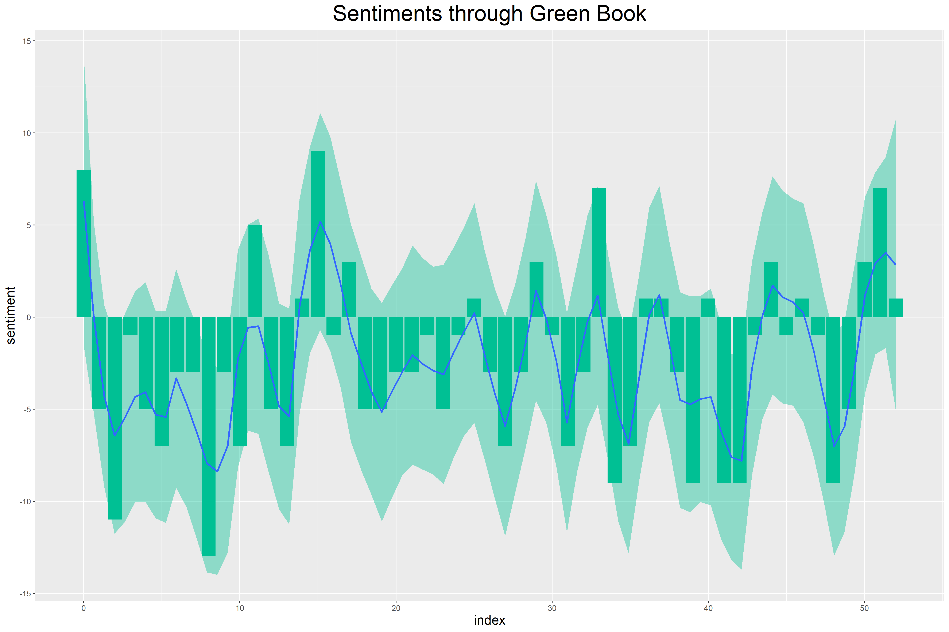
PRESENTING
BING SENTIMENT ANALYSIS GRAPHS

Slide 11
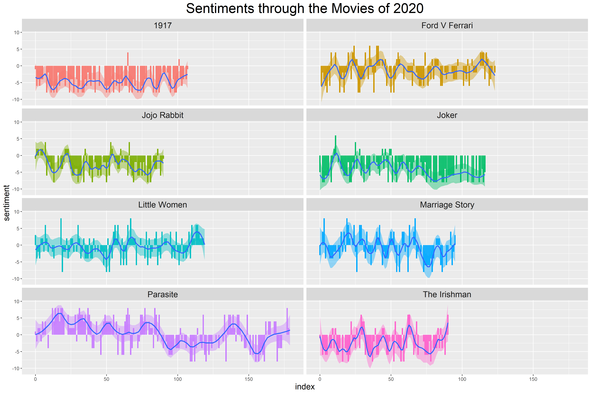
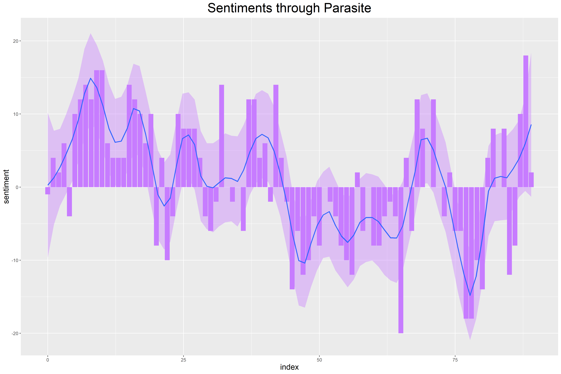
PRESENTING
BING SENTIMENT ANALYSIS GRAPHS

Slide 12
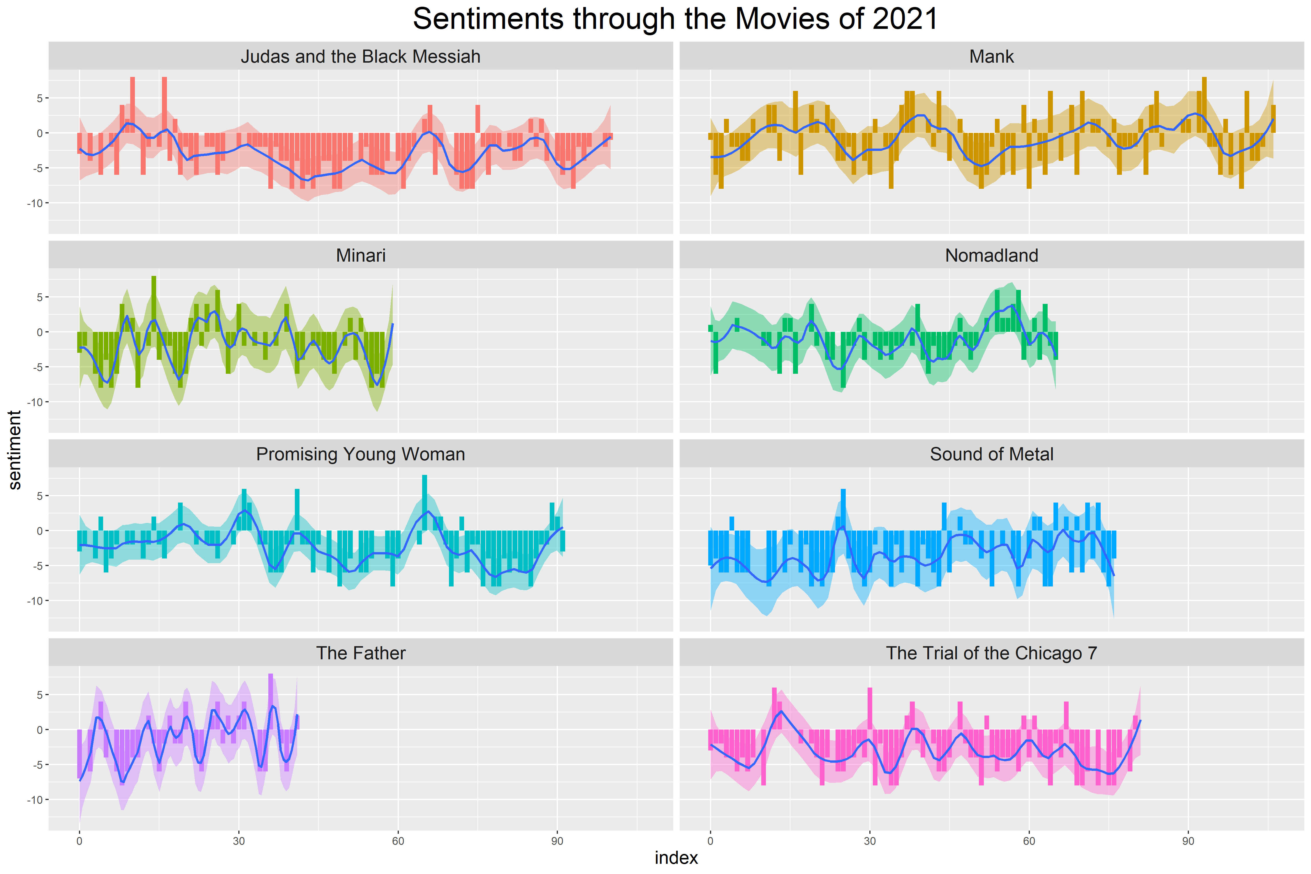
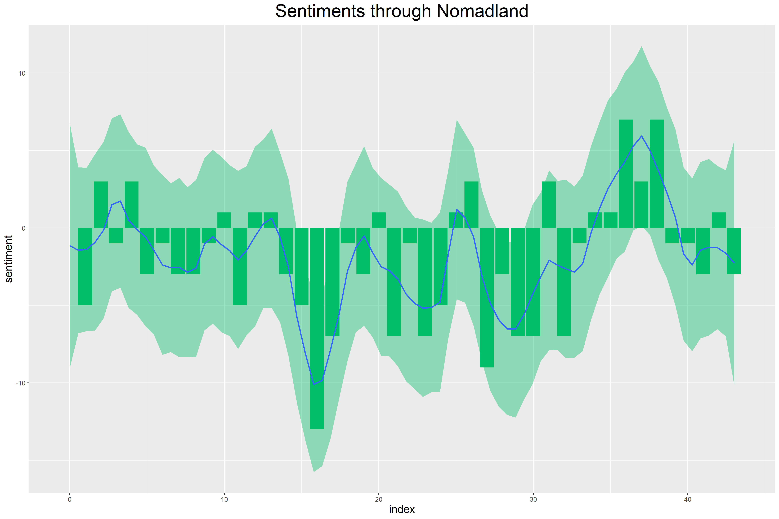
PRESENTING
BING SENTIMENT ANALYSIS GRAPHS

Slide 13
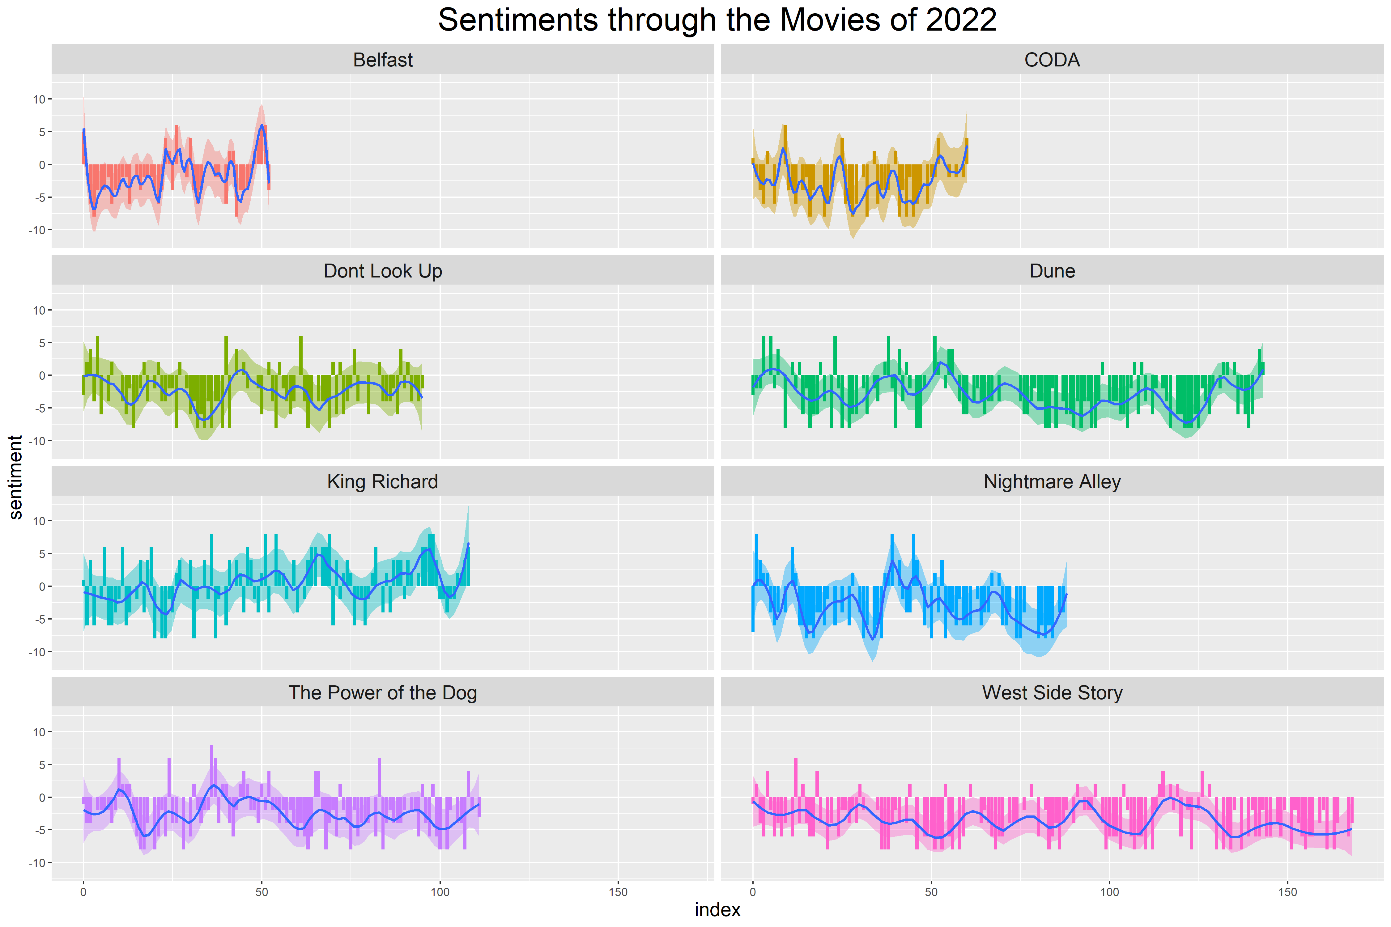
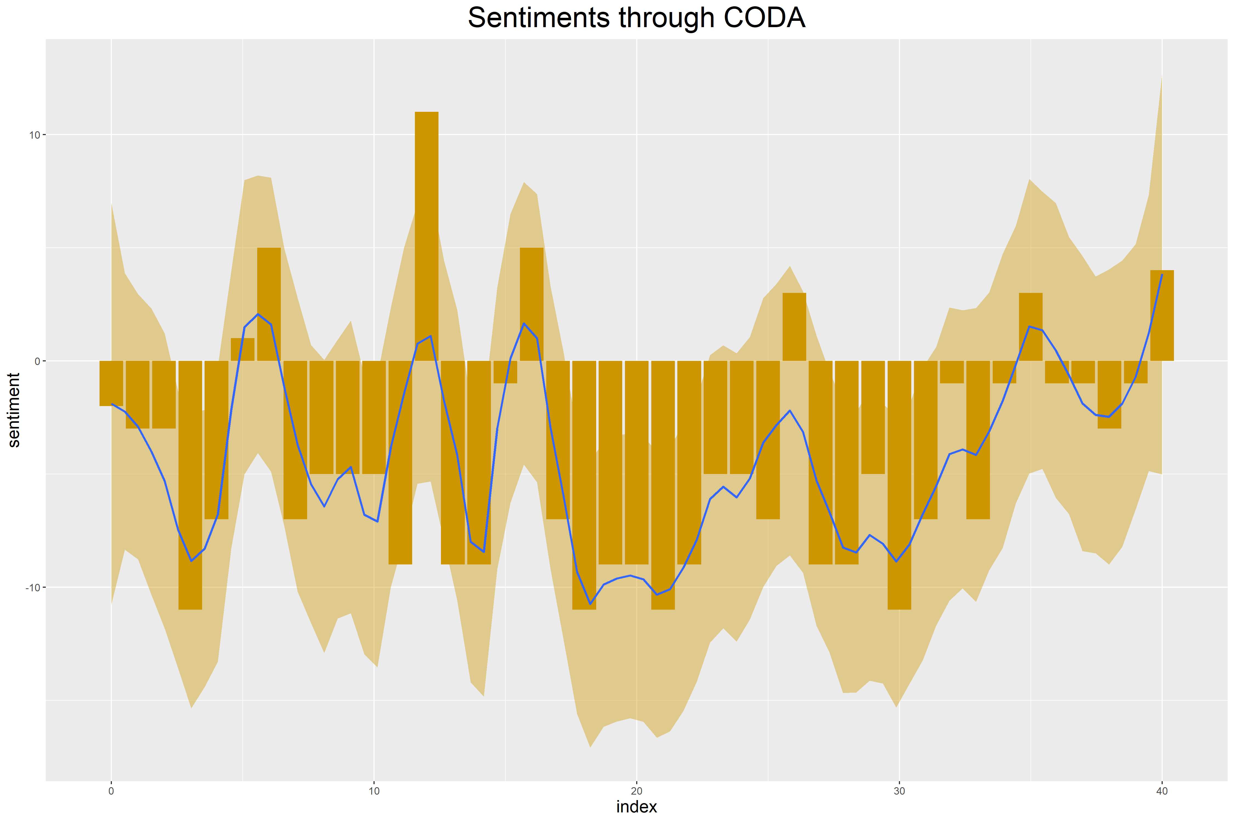
PRESENTING
BING SENTIMENT ANALYSIS GRAPHS

Slide 14
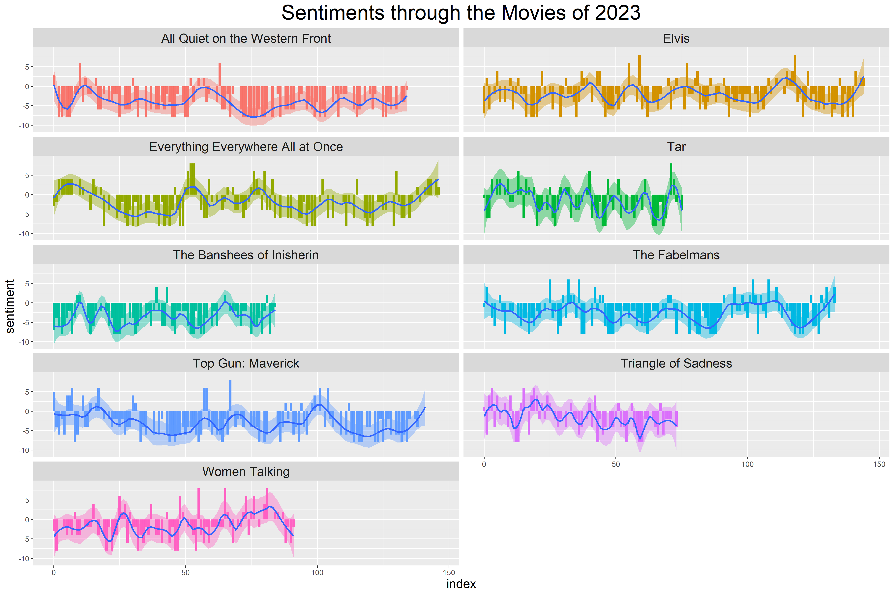
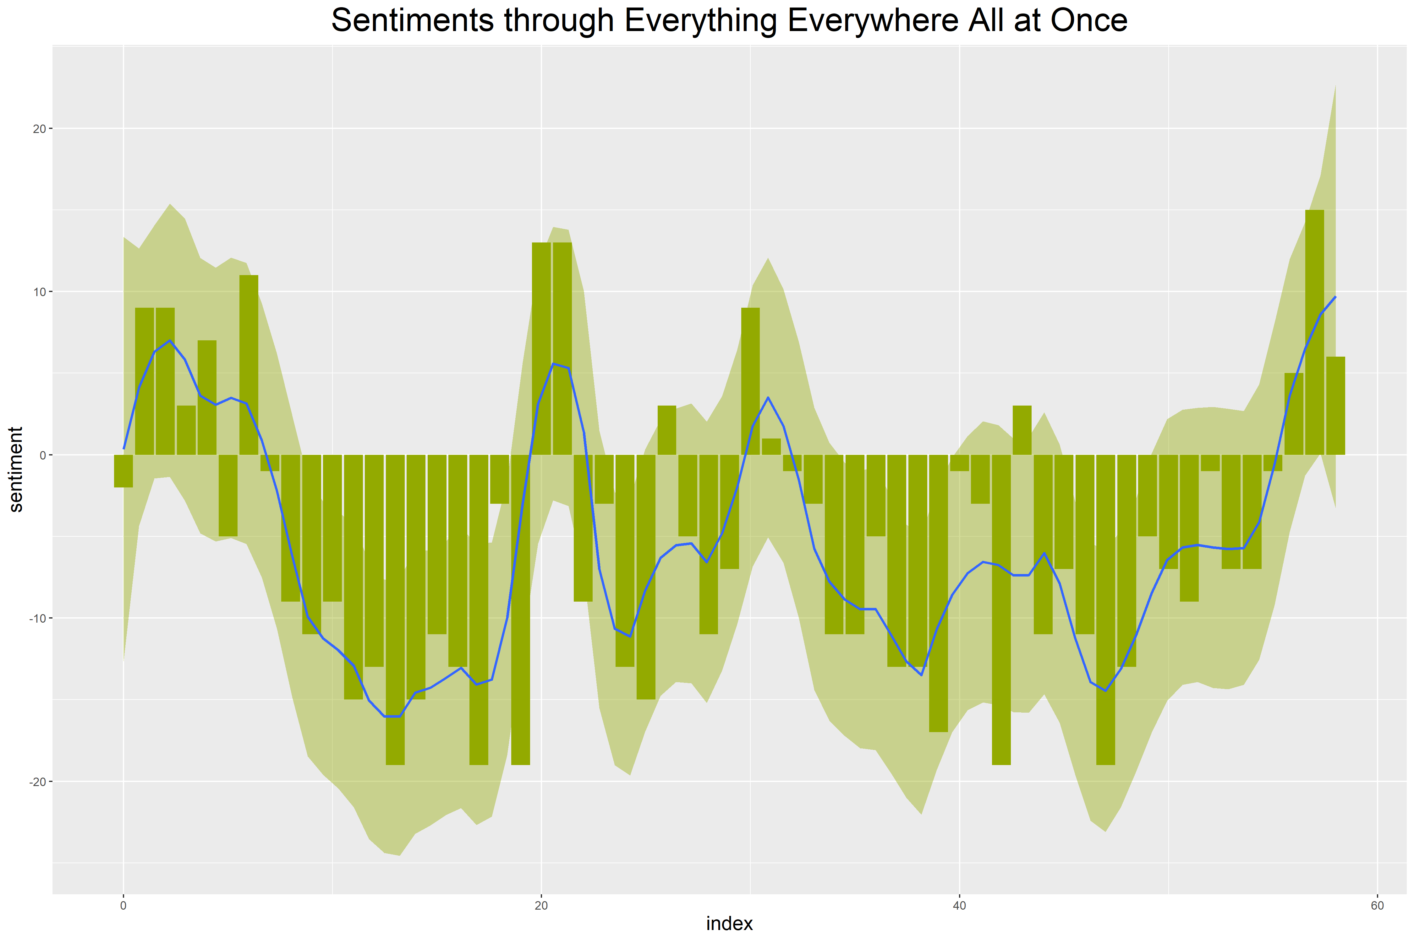
PRESENTING
BING SENTIMENT ANALYSIS GRAPHS

Slide 15
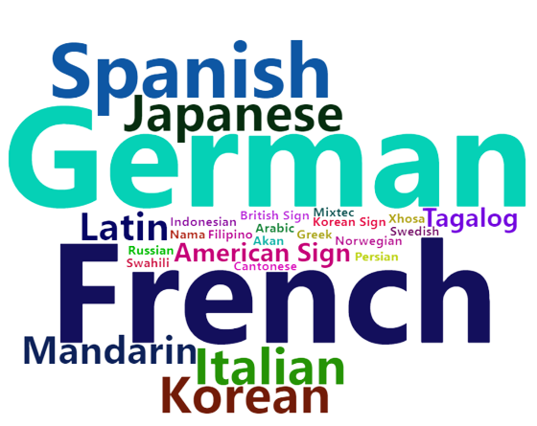
PRESENTING
WORD-CLOUD

Slide 16
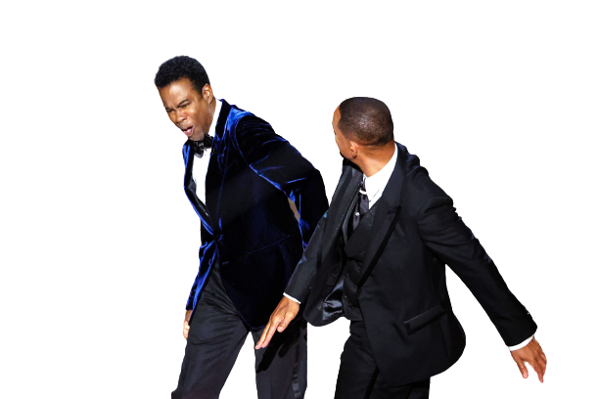
THANK YOU
Team Members:
Atharva Bhusari – ab2414
Abhinav Saxena – as4171
Nikhil Mishra – nm1116
Urjit Patil – up63

Slide 17
PRESENTING
REFERENCES
http://www.omdbapi.com/
https://deadline.com/

